Slide 1
Principals of Testing
Elizabeth Hendrickson
http://testobsessed.com/wp-content/uploads/2011/04/AgileTestingOverview.pdf
2008

Slide 10
Best Practices

Slide 11
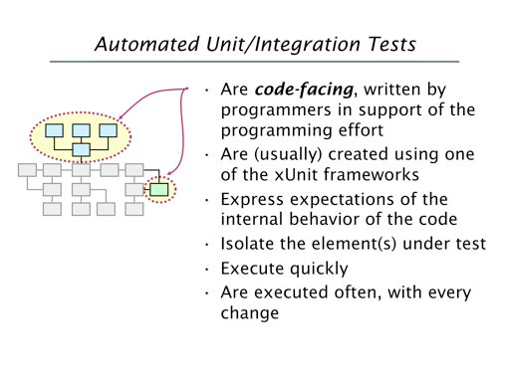

Slide 12
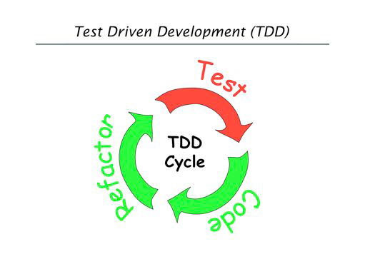

Slide 13
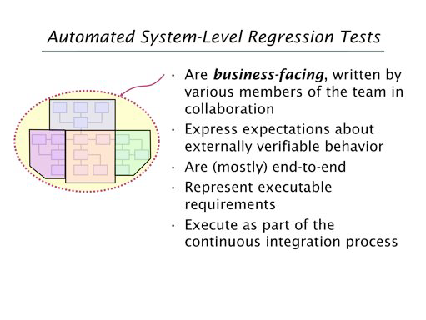

Slide 14
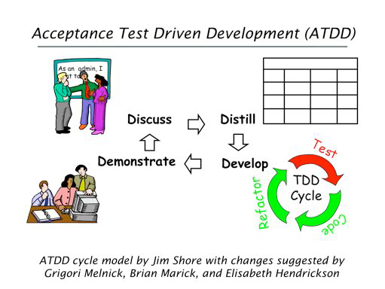

Slide 15
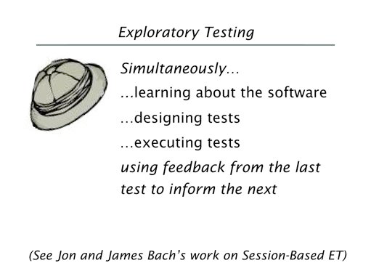

Slide 16
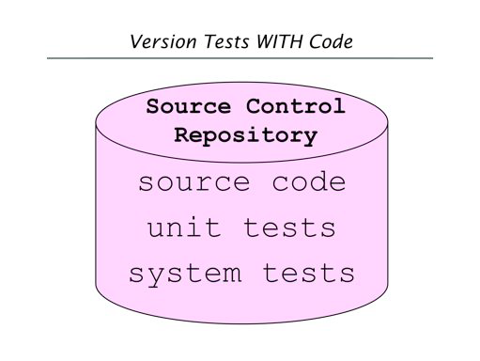

Slide 17
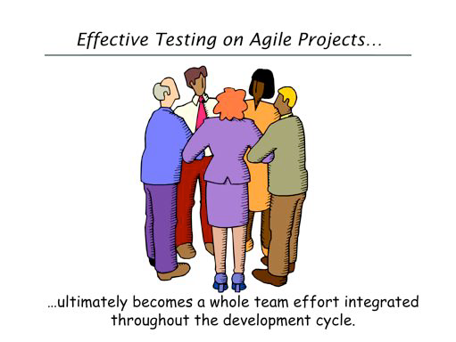

Slide 18
Principals of Testing
Quality tree Software
Elizabeth Hendrickson
www.qualityTree.com
2008

